Slide 1


Data Science Fundamentals
2
+
College of Computer Science And Information Technology
Classification
2
+
Session 1
Introduction

Slide 2
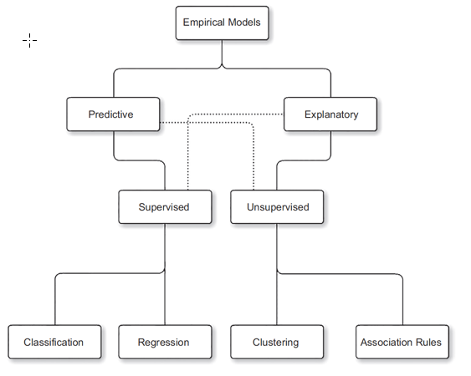
Types of Machine Learning

Slide 3
Classification algorithms
Is the process of predicting if a data point belongs to one of predefined classes. The prediction will be based on learning from known data set.
Type of Classification:
Binary Classification (compare between two categorical values)
Multi-Classification (compare between more than two categorical values)
Classification Algorithms examples:
Decision Trees
Random Forest
kNN
Naïve Bayesian
Neural Networks

Slide 4
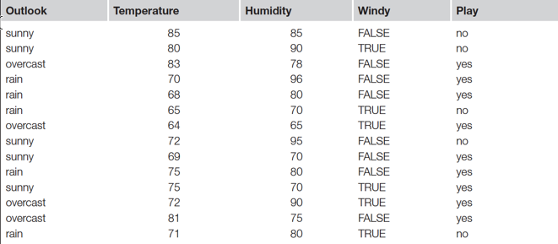
Table parameters (Input & Output)
Predictors / Attributes
Target / Class

Slide 5
Decision trees
A decision tree is a widely used machine learning algorithm for both classification and regression tasks. It’s a supervised learning method that builds a tree-like structure to make decisions or predictions based on input features. Decision trees are popular because they are easy to understand, interpret, and visualize.
Here’s how they work:
Structure: A decision tree consists of nodes and branches. Each internal node represents a feature or attribute, and each branch represents a decision rule based on that attribute. The leaves of the tree represent the output or the predicted class or value.
Splitting: The tree-building process involves selecting the best attribute to split the data at each internal node. This selection is typically based on criteria that maximize information gain (in classification) or reduce variance (in regression).
Recursive Process: The splitting process is recursive and continues until a stopping condition is met. This might be a predefined depth limit, a minimum number of data points in a node, or another criterion.
Prediction: To make a prediction, you start at the root of the tree and follow the decision rules down the branches until you reach a leaf node, which provides the output class or value.
Interpretability: Decision trees are highly interpretable, as you can trace the path from the root to a leaf to understand why a particular decision or prediction was made.
Overfitting: Decision trees are prone to overfitting, meaning they can become too complex and fit the training data noise. Techniques like pruning or using ensembles of trees (e.g., Random Forests) are often used to mitigate this issue.
Decision trees are used in a variety of fields, including finance, healthcare, and natural language processing. They are versatile and can handle both categorical and numerical data, making them a valuable tool in the machine learning toolkit.

Slide 6
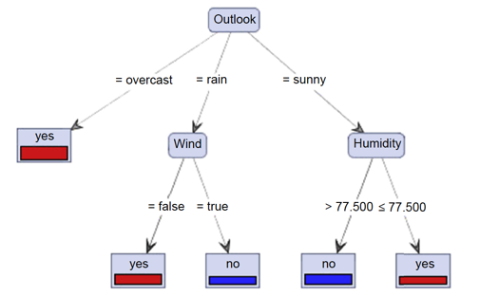
Decision Tree – Example 1

Slide 7
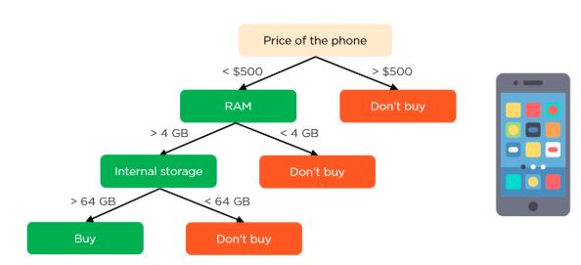
Decision tree – example 2
Parent node
Internal nodes / features
Leaf node / output

Slide 8
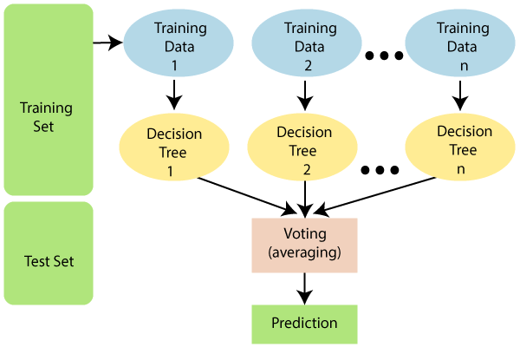
Random Forest
A random forest is a meta estimator that fits a number of decision tree classifiers on various sub-samples of the dataset and uses averaging to improve the predictive accuracy and control over-fitting. The sub-sample size is controlled with the max_samples parameter if bootstrap=True (default), otherwise the whole dataset is used to build each tree.
Random Forest parameters:
n_estimators.
max_depth
min_samples_split
min_samples_leaf
min_weight_fraction_leaf
max_features
etc
https://scikit-learn.org/stable/modules/generated/sklearn.ensemble.RandomForestClassifier.html

Slide 9
Why random forest?
Fast
Accurate
Handel large dataset
Consider as a feature selection

Slide 10
How RF work?
Here’s how a Random Forest works:
Bootstrapping: It starts by randomly selecting a subset of the training data with replacement. This subset is known as a “bootstrap sample.” Some data points may appear multiple times in the sample, while others may be omitted.
Feature Randomness: At each node of each decision tree in the Random Forest, a random subset of features is considered for splitting. This introduces diversity among the trees. The number of features to consider at each node is typically less than the total number of features in the dataset.
Building Decision Trees: The Random Forest creates a collection of decision trees, each trained on a bootstrap sample and using feature randomness. These trees are constructed using techniques like Gini impurity (for classification) or mean squared error (for regression) to determine the best attribute for splitting.
Voting or Averaging: For classification tasks, the Random Forest combines the predictions of individual trees through majority voting. Each tree’s prediction is counted, and the class with the most votes becomes the final prediction. For regression tasks, the predictions are averaged.
Ensemble Effect: The ensemble of decision trees helps reduce the variance and overfitting that individual trees might exhibit. By combining multiple trees with different perspectives, the Random Forest provides a more stable and accurate prediction.
Out-of-Bag (OOB) Error: Random Forests use the out-of-bag error to estimate the performance of the model. This is done by evaluating each tree on the data points it didn’t see during its construction (left out due to the bootstrap sampling). The OOB error serves as a useful indicator of model performance.
Feature Importance: Random Forests can also provide information about feature importance. This helps identify which features have the most influence on the predictions by considering how much they reduce impurity when used for splitting nodes in the trees.

Slide 11
Random forest example
Suppose you have a dataset with two numerical features, “Temperature” and “Humidity,” and you want to predict whether a day is suitable for outdoor activities (“Yes” or “No”).
Day | Temperature | Humidity | Outdoor Activities
1 | 70 | 60 | Yes
2 | 82 | 50 | Yes
3 | 72 | 90 | No
4 | 65 | 75 | No
5 | 85 | 70 | Yes

Slide 12
Now, let’s create a simplified Random Forest with two decision trees.
Here’s how it might work:Decision Tree 1:
A random subset of data points is sampled with replacement to create a training set. Let’s say we get these data points:
A decision tree is built on this subset. The tree might split based on Temperature and Humidity to make predictions.
For example, the tree could look like this:
If Temperature >= 70 and Humidity <= 80, then "Yes"Else "No"
Day | Temperature | Humidity | Outdoor Activities
1 | 70 | 60 | Yes
3 | 72 | 90 | No
4 | 65 | 75 | No
5 | 85 | 70 | Yes

Slide 13
Decision Tree 2:
Another random subset of data points is sampled with replacement.
Let’s say we get these data points:s
A different decision tree is built on this subset.
For example, the tree could look like this:
If Temperature > 75 and Humidity <= 85, then "Yes"Else "No"
Day | Temperature | Humidity | Outdoor Activities
2 | 82 | 50 | Yes
3 | 72 | 90 | No
4 | 65 | 75 | No
5 | 85 | 70 | Yes

Slide 14
Combining the Random Forest
In a Random Forest, the final prediction is made by aggregating the results from individual decision trees.
For classification, it could be done through majority voting:
For Day 1, Tree 1 predicts “Yes,” and Tree 2 predicts “Yes.” So, the Random Forest predicts “Yes.”
For Day 3, Tree 1 predicts “No,” and Tree 2 predicts “No.” So, the Random Forest predicts “No.”
This is a simplified example to illustrate the basic concept of Random Forest. In practice, Random Forests involve more trees, larger datasets, and more features.

Slide 15
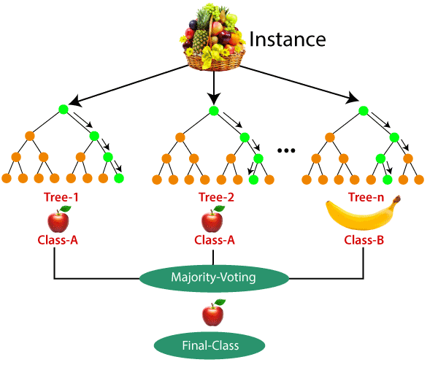
Random Forest
https://www.javatpoint.com/machine-learning-random-forest-algorithm

Slide 16
Regression

Slide 17
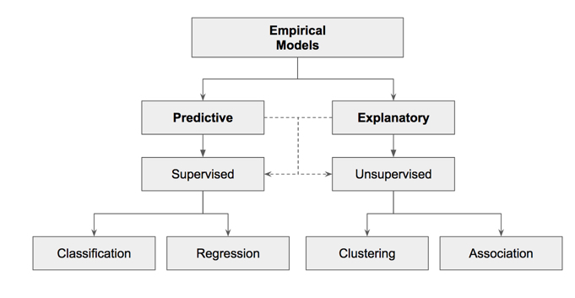

Slide 18
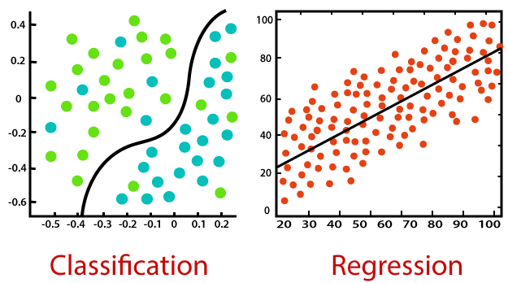
Classification Vs Regression

Slide 19
Regression Algorithm | Classification Algorithm
In Regression, the output variable must be of continuous nature or real value. | In Classification, the output variable must be a discrete value.
The task of the regression algorithm is to map the input value (x) with the continuous output variable(y). | The task of the classification algorithm is to map the input value(x) with the discrete output variable(y).
Regression Algorithms are used with continuous data. | Classification Algorithms are used with discrete data.
In Regression, we try to find the best fit line, which can predict the output more accurately. | In Classification, we try to find the decision boundary, which can divide the dataset into different classes.
Regression algorithms can be used to solve the regression problems such as Weather Prediction, House price prediction, etc. | Classification Algorithms can be used to solve classification problems such as Identification of spam emails, Speech Recognition, Identification of cancer cells, etc.
The regression Algorithm can be further divided into Linear and Non-linear Regression. | The Classification algorithms can be divided into Binary Classifier and Multi-class Classifier.

Slide 20
What is regression?
Regression is a process of finding the correlations between dependent and independent variables. It helps in predicting the continuous variables such as prediction of Market Trends, prediction of House prices, etc.
The task of the Regression algorithm is to find the mapping function to map the input variable(x) to the continuous output variable(y).
Example: Suppose we want to do weather forecasting, so for this, we will use the Regression algorithm. In weather prediction, the model is trained on the past data, and once the training is completed, it can easily predict the weather for future days.

Slide 21
Regression algorithms
Simple Linear Regression
Multiple Linear Regression
Polynomial Regression
Support Vector Regression
Decision Tree Regression
Random Forest Regression

Slide 22
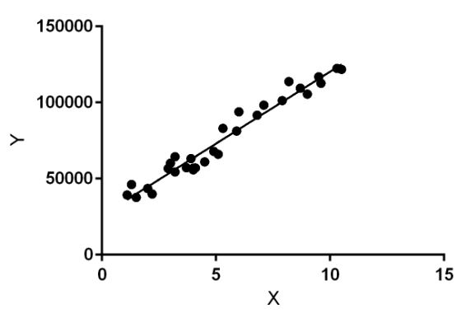
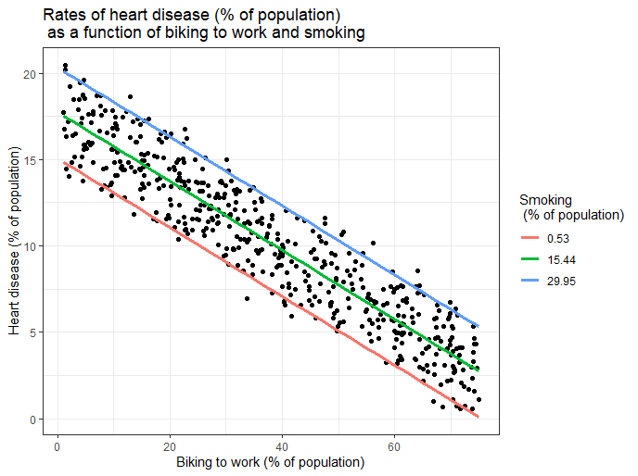
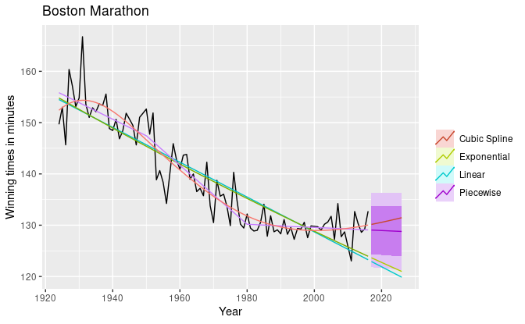
Types of regression models
Linear regression
There are several regression models, here we will illustrate the differences between linear, non-linear and multi-linear regression models..
Linear regression model
Non-linear regression model
Multiple regression model
None Linear
Multiple Linear
Notes:
Linear regression model
A linear regression model is used to depict a relationship between variables that are proportional to each other. Meaning, that the dependent variable increases/decreases with the independent variable.
In the graphical representation, it has a straight linear line plotted between the variables. Even if the points are not exactly in a straight line (which is always the case) we can still see a pattern and make sense of it.
For example, as the age of a person increases, the level of glucose in their body increases as well.
Non-linear regression model
In the non-linear regression model, the graph doesn’t show a linear progression. Depending on how the response variable reacts to the input variable, the line will rise or fall showing the height or depth of the effect of the response variable.
To know that a non-linear regression model is the best fit for your scenario, make sure you look into your variables and their patterns. If you see that the response variable is showing not-so-constant output to the input variable, you can choose to use a non-linear model for your problem.
For example, a patient’s response to treatment can be good or bad depending on their body’s tendency and willpower
Multiple regression model
A multiple regression model is used when there is more than one independent variable affecting a dependent variable. While predicting the outcome variable, it is important to measure how each of the independent variables moves in their environment and how their changes will affect the output or target variable.
For example, the chances of a student failing their test can be dependent on various input variables like hard work, family issues, health issues, etc.

Slide 23
Linear Regression
Linear regression is a statistical method used to model the relationship between a dependent variable and one or more independent variables by fitting a linear equation to the observed data. The goal is to find the best-fitting line (or hyperplane in the case of multiple independent variables) that minimizes the sum of the squared differences between the predicted and actual values.
Example:
Suppose you want to predict house prices based on their square footage. In this case:
The dependent variable (Y) is the house price.
The independent variable (X) is the square footage of the house.

Slide 24
You collect data on various houses, recording their square footage and sale prices. You can use linear regression to find a line that best fits the data points.
The linear regression equation would look like:Y = b0 + b1*X
Y is the predicted house price.
b0 is the intercept (the price when the square footage is 0).
b1 is the slope (how much the price increases for each additional square foot).
By analyzing the data, the linear regression model estimates the values of b0 and b1 that minimize the errors in predicting house prices. Once you have these values, you can use the equation to predict house prices for any given square footage.
For example, if the linear regression model finds that b0 = $50,000 and b1 = $100 per square foot, you can predict that a house with 1,500 square feet would be priced at $200,000
Y = 50,000 + 100 * 1,500 = 200,000

Slide 25
Nonlinear Regression
Nonlinear regression is a statistical method used to model the relationship between a dependent variable and one or more independent variables when that relationship is not linear. Instead of fitting a straight line or hyperplane, nonlinear regression fits a more complex, nonlinear equation to the data. Here’s an example to illustrate nonlinear regression:
Example: Modeling Population Growth
Suppose you want to model the population growth of a species over time. In this case:
The dependent variable (Y) is the population size.
The independent variable (X) is the time in years.

Slide 26
You collect data on the population size of the species at various points in time. If you observe that the population growth does not follow a linear pattern, but rather shows exponential growth, you might choose a nonlinear regression model to capture this behavior.
A common nonlinear equation for modeling exponential growth is:Y = a * e^(b * X)
Y is the predicted population size.
a is a constant representing the initial population size.
b is a constant representing the growth rate.
e is the base of the natural logarithm (approximately 2.71828).
By using nonlinear regression, you can estimate the values of a and b that best fit the observed data points. This will provide a more accurate model for population growth over time, considering the nonlinear nature of the relationship.
For example, if the nonlinear regression model finds that a = 100 and b = 0.1, you can use the equation to predict the population size for any given year. If you want to know the population size after 10 years, you would calculate it as:Y = 100 * e^(0.1 * 10) ≈ 271.83

Slide 27
Multi-linear Regression
Multilinear regression, also known as multiple linear regression, is a statistical method used to model the relationship between a dependent variable and two or more independent variables. It extends the concept of simple linear regression to situations where there are multiple predictors.
Example: Suppose you want to predict students’ exam scores based on two independent variables: the number of hours they studied and the number of hours they slept the night before the exam.
In this case:
The dependent variable (Y) is the exam score.
The independent variables (X1 and X2) are the hours of study and the hours of sleep, respectively.

Slide 28
You collect data from a group of students, recording their exam scores, study hours, and sleep hours.
The multilinear regression equation would look like:Y = b0 + b1*X1 + b2*X2
Y is the predicted exam score.
b0 is the intercept (the predicted score when both study and sleep hours are zero).
b1 is the coefficient for study hours, indicating how the score changes for each additional hour of study.
b2 is the coefficient for sleep hours, indicating how the score changes for each additional hour of sleep.
By using multilinear regression, you can estimate the values of b0, b1, and b2 that best fit the data, allowing you to predict exam scores based on the hours of study and sleep for a given student.
For example, if the multilinear regression model finds that b0 = 60, b1 = 5, and b2 = 2, you can predict the exam score for a student who studied for 4 hours and slept for 7 hours as follows:
Y = 60 + 5 * 4 + 2 * 7
= 60 + 20 + 14 = 94

